Slide 1
Computer Programming
Flowchart

Slide 2
Objectives
Flowchart
Calculations
Decision Making (Selection)
Iteration (Repetition)

Slide 3
Flowchart

Slide 4
Flowchartخريطة سير العمليات
Graphical representation of an algorithm
Components:
Arrows/lines: Flow of control
Parallelogram: Indicates input and output operations
Rectangle symbol (action symbol): Indicates any type of action/computational step
Oval symbol: Indicates the start or the end of a program or a section of code
Diamond: Decision.

Slide 5
Flowchart Notations
Arrows
Diamond
Parallelogram
Oval
Rectangle

Slide 6
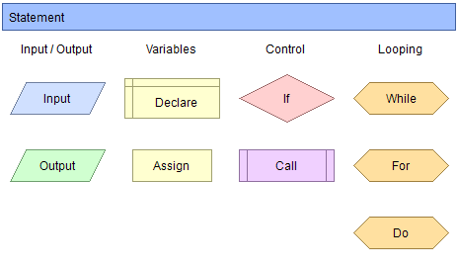
Flowchart Notations

Slide 7
Calculations

Slide 8
Example: Add Two Numbers
START
READ
A,B
Sum = A+B
PRINT
Sum
Stop

Slide 9
Example: Add Three Numbers
START
READ
A,B,C
Sum = A + B + C
PRINT
Sum
Stop

Slide 10
Example: Average of Three Numbers
START
READ
A,B,C
Sum= A+B+C
Avg = (A+B+C) / 3
Avg = Sum / 3
PRINT
Avg
Stop

Slide 11
Example: Print “Hello”
START
PRINT
“Hello”
Stop

Slide 12
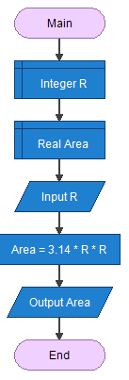
Example: Area of a Circle
START
READ
R
Area = 3.14 * R * R
PRINT
Area
Stop

Slide 13
Decision Making
(Selection)

Slide 14
Example: Max. of Two Number
START
READ
N1, N2
PRINT
N1
Yes
No
PRINT
N2
If N1>N2
Stop

Slide 15
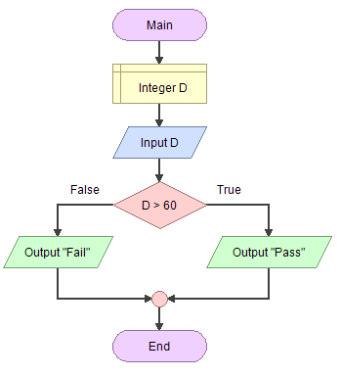
Example: Pass or Fail
START
READ
D
PRINT
“Pass”
Yes
No
PRINT
“Fail”
If D>=60
Stop

Slide 16
Example: Degree to Grade
START
READ
D
PRINT
“A”
Yes
No
No
No
PRINT
“F”
If D>=90
If D>=80
If D>=70
Yes
Yes
PRINT
“B”
PRINT
“C”
Stop

Slide 17
Iteration (Repetition)

Slide 18
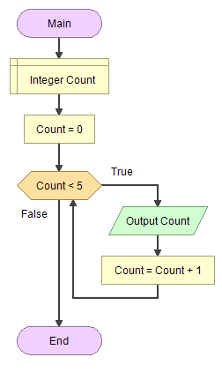
Example: Print numbers from 0 to 4

Slide 19
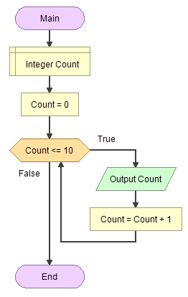
Example: Print numbers from 0 to 10

Slide 20
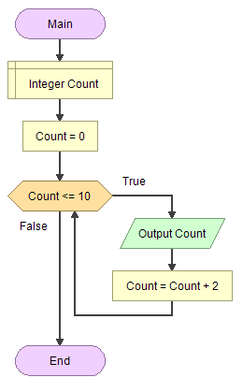
Example: Print even numbers from 0 to 10

Slide 21
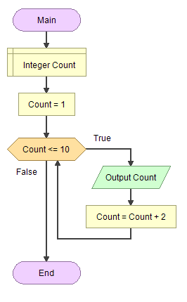
Example: Print odd numbers from 0 to 10

Slide 22
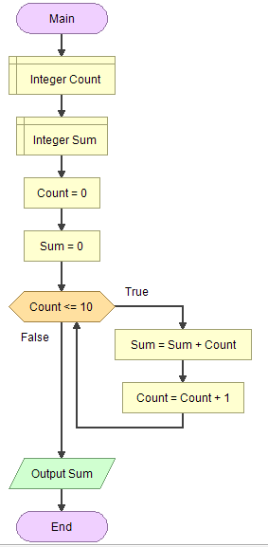
Example: Print the summation of the numbers from 0 to 10

